Slide 1





Approaches to Understanding Space Weathering on Airless Bodies
Emily Clark
Mentor: Dr. Mark Loeffler
School: Northern Arizona University
Arizona NASA Space Grant Statewide Student Research Symposium
Arizona State University
April 22, 2023

Slide 2
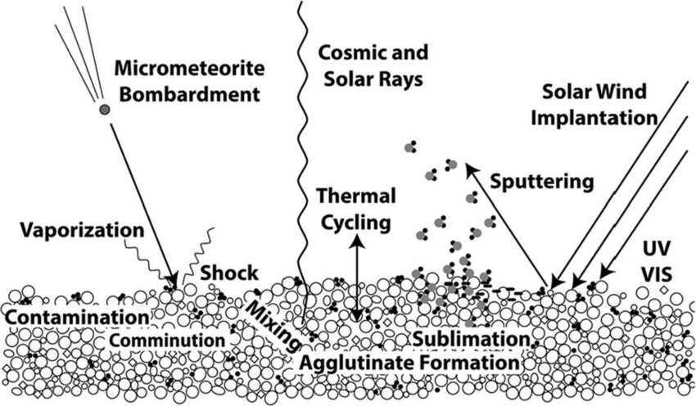
What is Space Weathering?
Most weathering on Earth is caused by atmospheric processes
There are many bodies without atmospheres that get weathered
  Asteroids
  Moons
  Dwarf Planets
How is this possible?
  Micrometeorite Bombardment
  Cosmic Rays
  Solar Wind
Pieters & Noble 2016

Slide 3
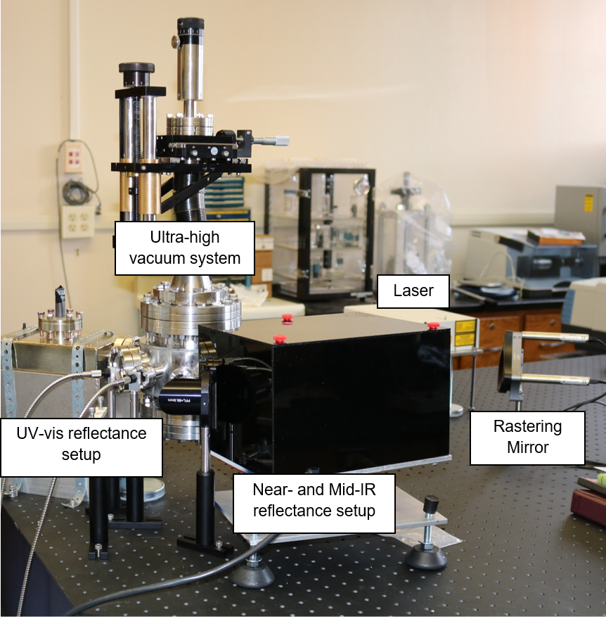
How Do We Simulate Asteroid Surfaces?
Make mixtures of light and dark materials that simulate asteroid surfaces
  Graphite
  Magnetite
  Silicon Dioxide
Press the mixtures
Put them in a vacuum environment to simulate the vacuum of space
Loeffler 2018

Slide 4
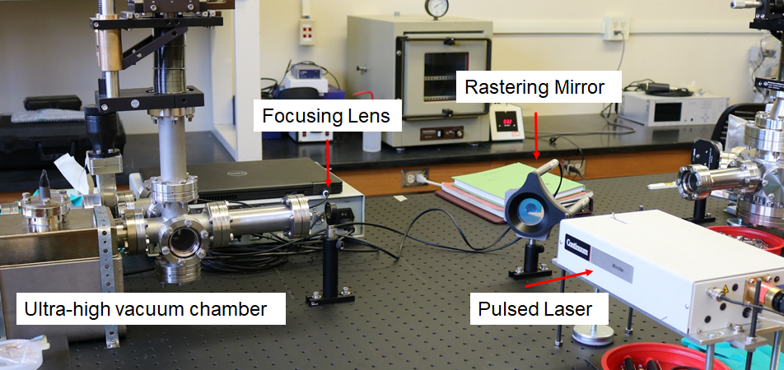
How Do We Simulate Space Weathering?
Irradiate the mixture with a laser to mimic:
  Micrometeorite impacts
Collect reflectance spectra
  Near-IR (0.7-2.5 µm)
  UV-Vis (0.25-0.9 µm)
Compare to remote sensing
Loeffler 2018

Slide 5
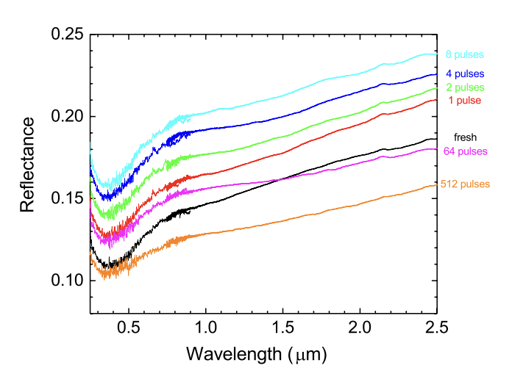
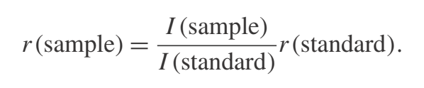
Spectral Changes Induced by Laser Irradiation
Reflectance vs. wavelength
Example Case
  FeS
Hapke 2012
Prince et al. 2020

Slide 6
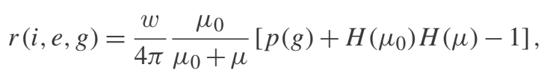
Hapke Modeling
Equation we need:
Reflectance
Hapke 2012

Slide 7
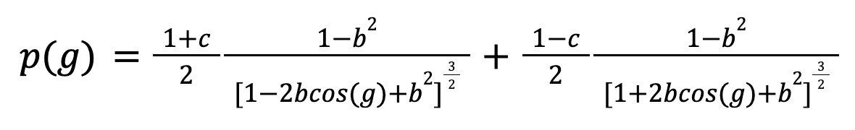
Hapke Modeling With Python
Improvements I made to the code:
Henyey-Greenstein Phase Function:
Used Legendre Polynomials to expand the phase function to 10 terms
Added a plotting feature
Clark 2023

Slide 8
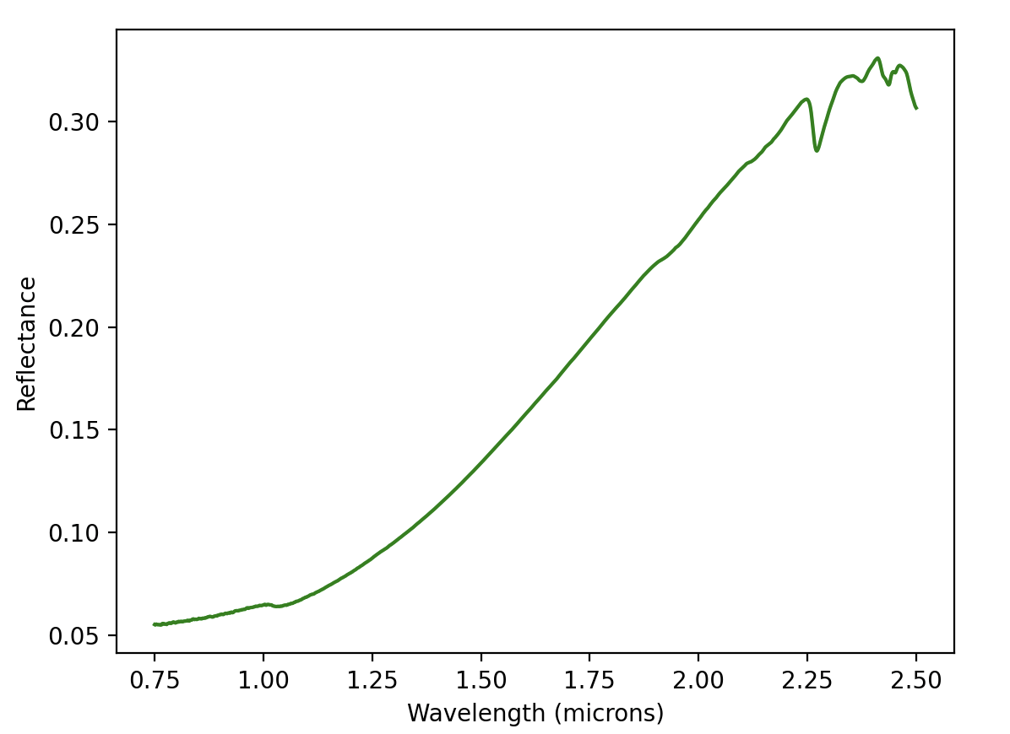

Hapke Modeling With Python
Output
  Very useful for generating figures based on collected data
Before:
After:
Clark 2023
Clark 2023

Slide 9
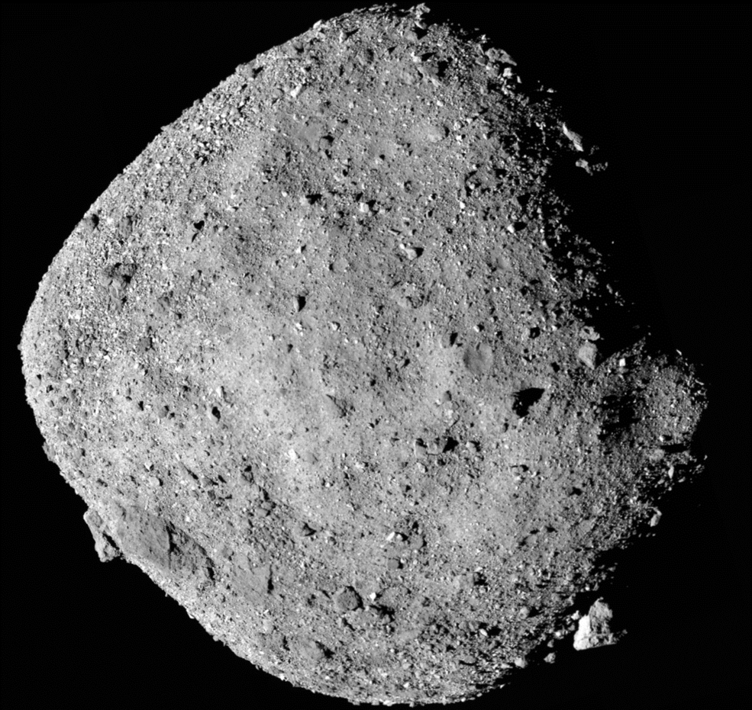
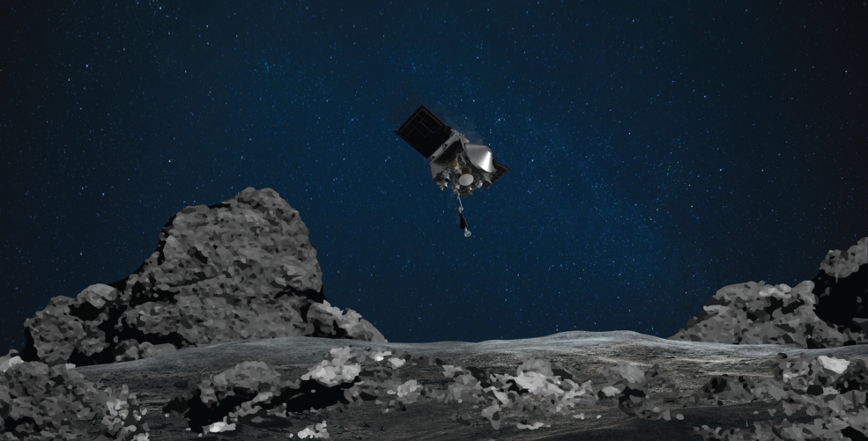
Significance of this Research
Understanding Evolution of Airless Bodies
OSIRIS-REx mission
  Better analysis of collected samples/data
NASA 2020
NASA 2020

Slide 10
Thank You

